Slide 1




Exploring the Exciting World of Modern .NET Development
Matthew Leibowitz @mattleibow

Slide 2

.NET
https://dot.net/

Slide 3
.NET Framework
Works on Windows only
Installed by default
Mature since 2002
No new features to introduce bugs
Supports building web, GUI and console apps
Only supported in Visual Studio
Thanks, but no thanks!
https://learn.microsoft.com/dotnet/framework

Slide 4









.NET
Cloud
Web
Desktop
Mobile
Gaming
IoT
AI
Visual Studio
Visual Studio Code
CLI
Windows
Linux
macOS
NuGet
GitHub
Components, tools, library vendors
Tools
Operating system
Ecosystem
https://dotnet.microsoft.com/learn/dotnet/what-is-dotnet?

Slide 5




Any Platform
Blazor
.NET MAUI

Slide 6
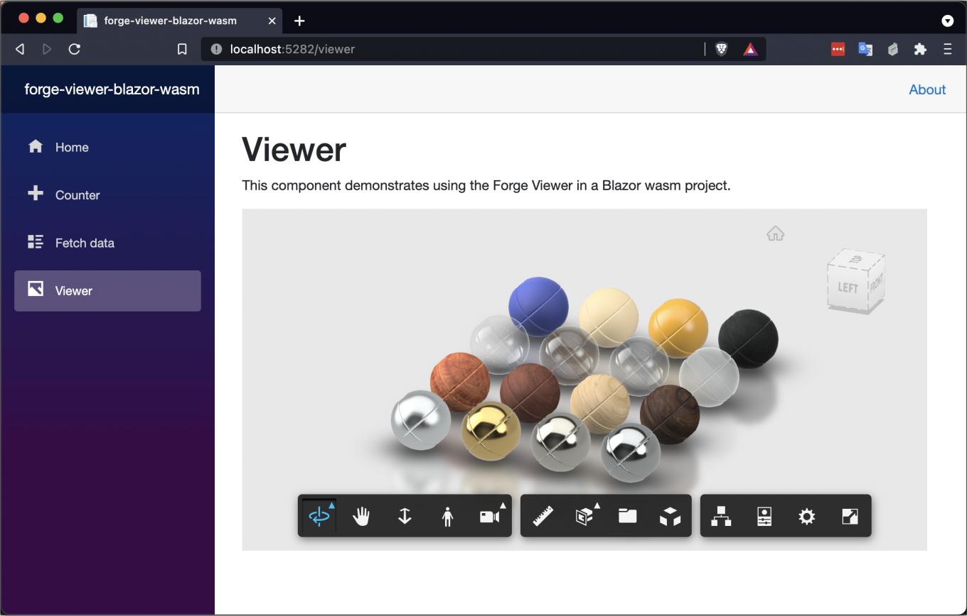
First Party
Blazor
https://dotnet.microsoft.com/apps/aspnet/web-apps/blazor

Slide 7
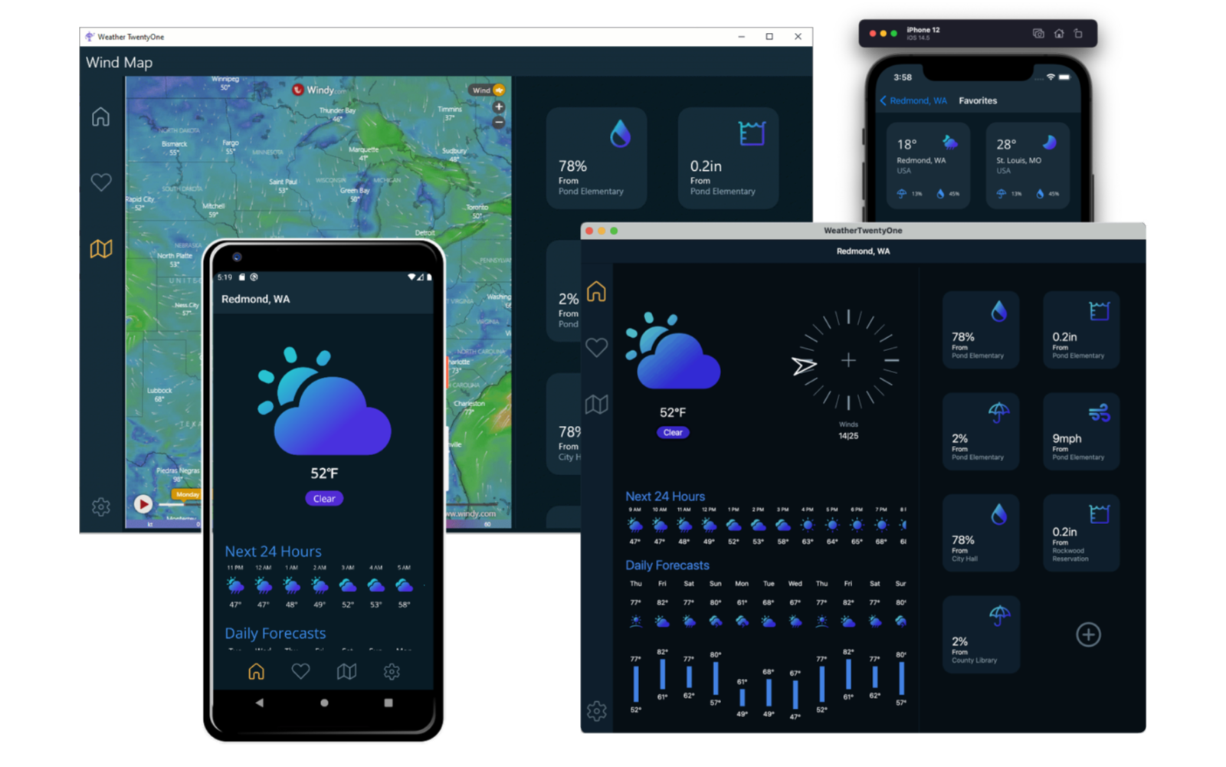
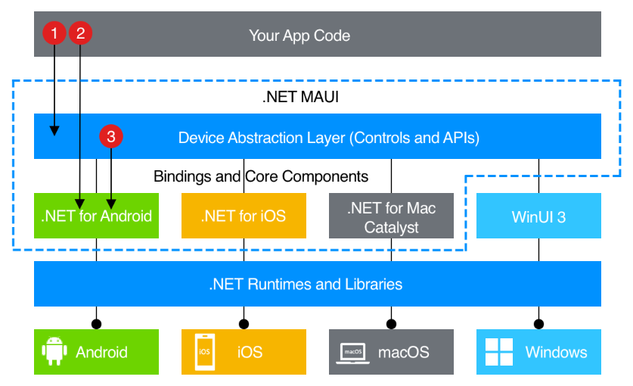
First Party
.NET MAUI
https://dotnet.microsoft.com/apps/maui

Slide 8

BLAZOR
C#, HTML, JS, CSS
BLAZOR + .NET MAUI
.NET MAUI, WinUI, WPF
C#, XAML
Reach
Depth
Websites and PWAs
Hybrid
Native
https://learn.microsoft.com/aspnet/core/blazor/hybrid

Slide 9
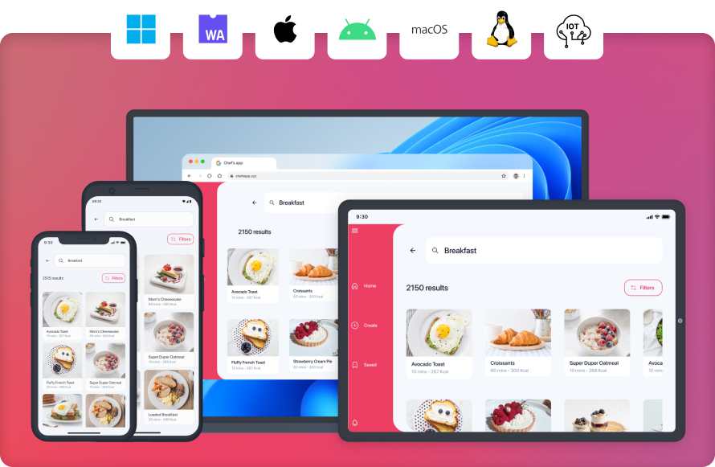
Third Party
https://platform.uno

Slide 10
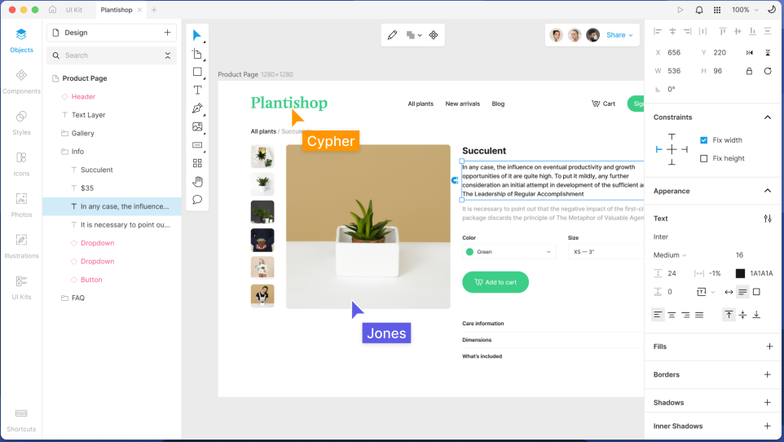
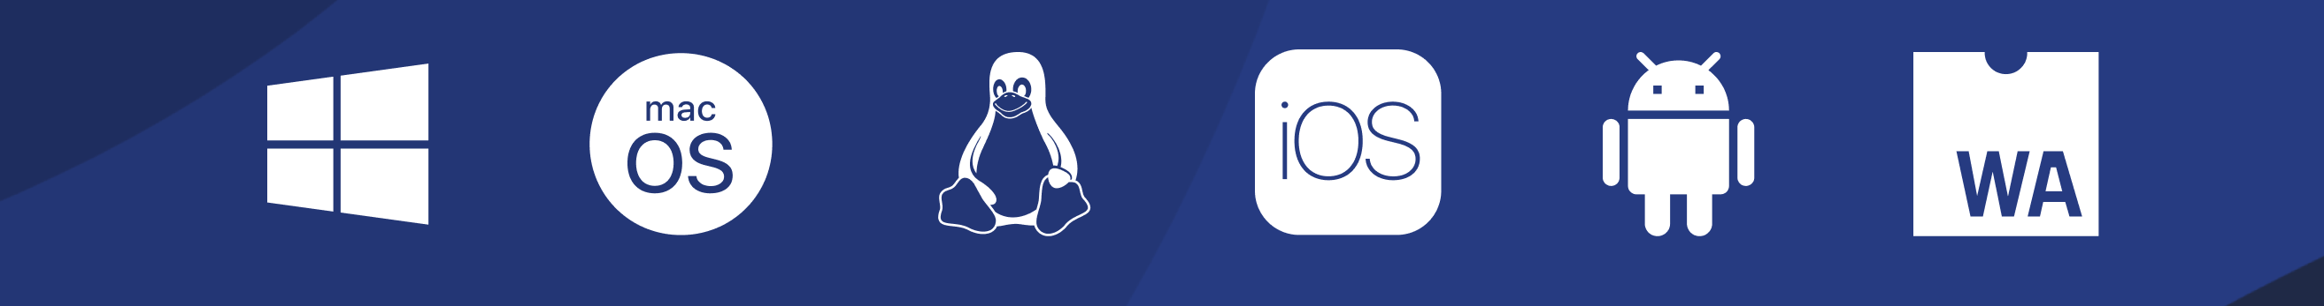
Third Party
https://www.avaloniaui.net

Slide 11

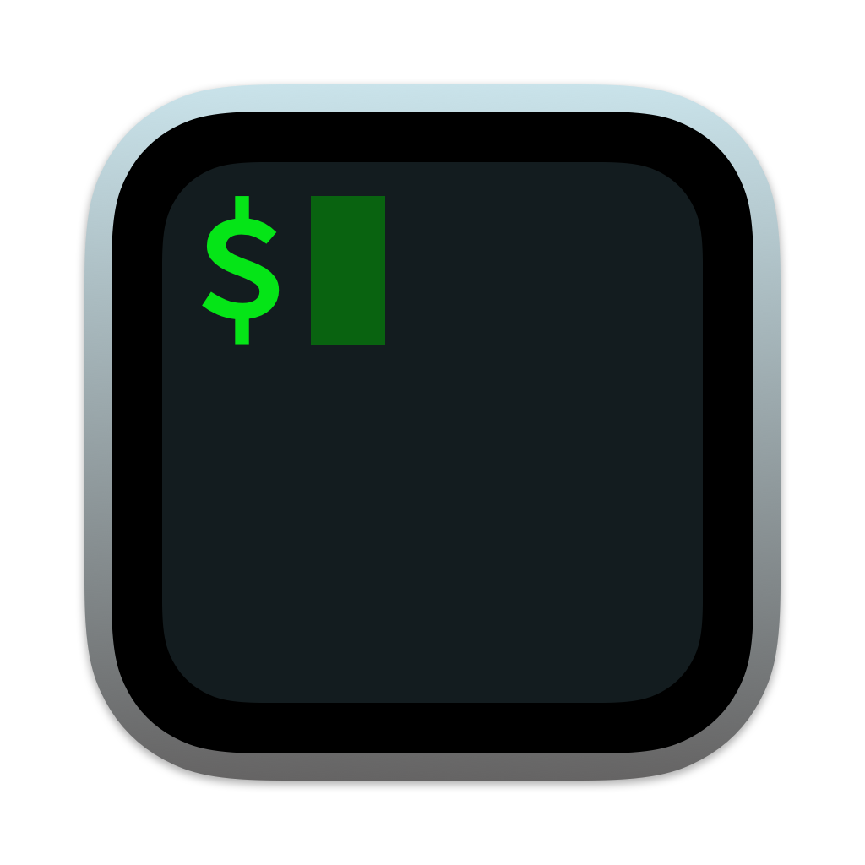


Any Environment
Visual Studio
Command Line
JetBrains Rider
Visual Studio Code
https://dotnet.microsoft.com/platform/tools

Slide 12
Visual Studio Code
https://code.visualstudio.com

Slide 13
Visual Studio Code
Lightweight
Powerful
Source code editor
Windows, macOS, Linux
Rich ecosystem of extensions

Slide 14
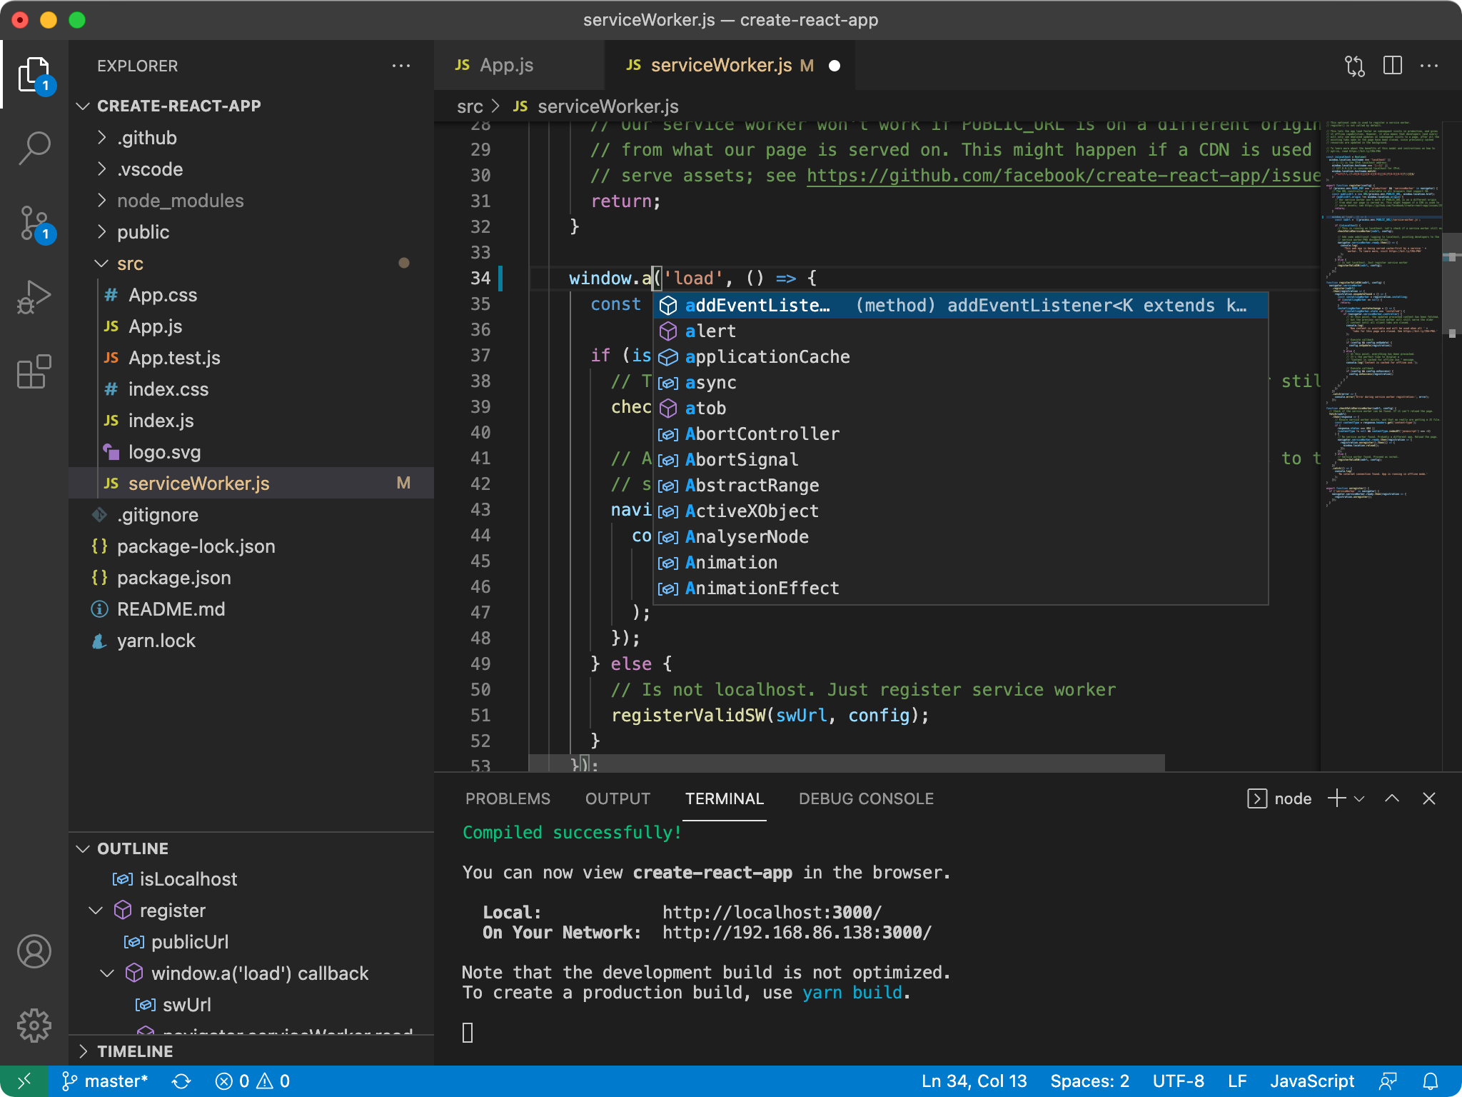

Slide 15

C# Dev Kit for Visual Studio Code
https://marketplace.visualstudio.com/items?itemName=ms-dotnettools.csdevkit

Slide 16
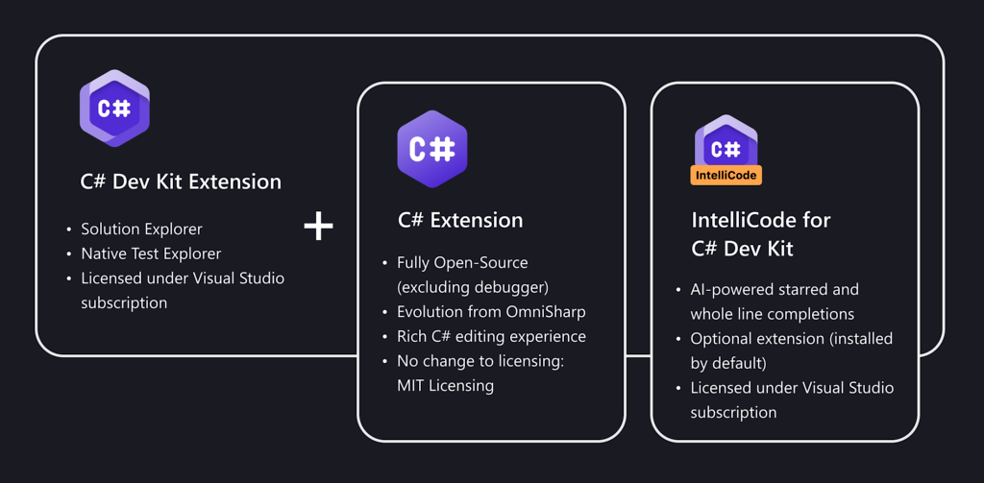
Solution Explorer
Test Explorer
Hot Reload
Licensed under Visual Studio subscription
https://marketplace.visualstudio.com/items?itemName=ms-dotnettools.csdevkit

Slide 17

.NET MAUI Dev Kit for VS Code
https://marketplace.visualstudio.com/items?itemName=ms-dotnettools.dotnet-maui

Slide 18
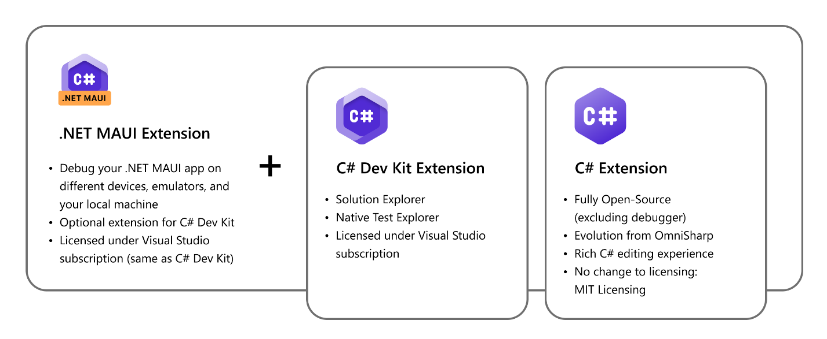
Solution Explorer
Test Explorer
Hot Reload
Licensed under Visual Studio subscription
https://marketplace.visualstudio.com/items?itemName=ms-dotnettools.dotnet-maui

Slide 19
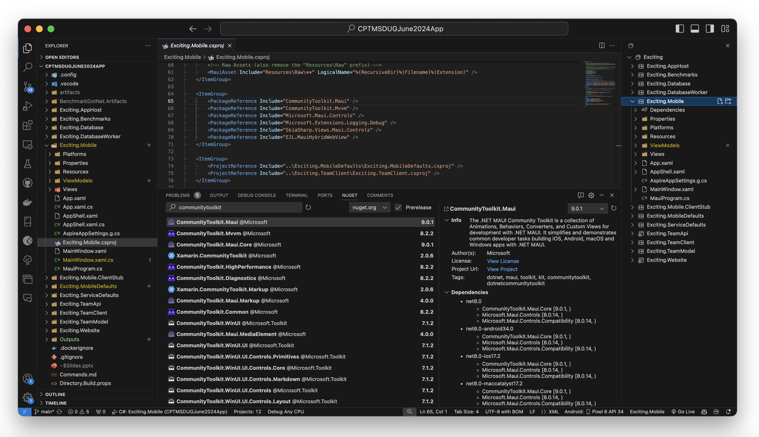
NuGet Gallery VS Code Extension
Community
https://marketplace.visualstudio.com/items?itemName=patcx.vscode-nuget-gallery

Slide 20
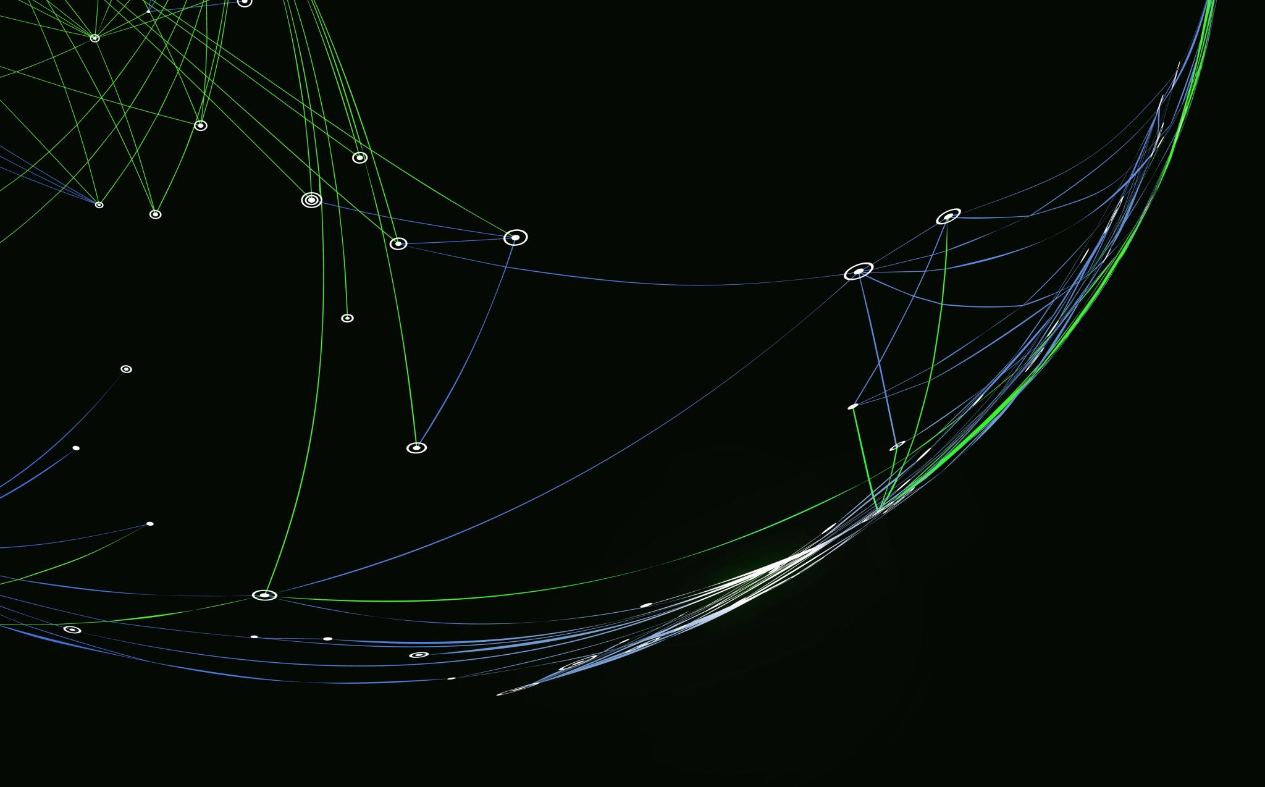
VS Code + .NET MAUI + Hot Reload Demo

Slide 21

Dev Tunnels
https://learn.microsoft.com/azure/developer/dev-tunnels

Slide 22
Local Endpoint
Public Endpoint
Anything
Dev Tunnel
http://localhost:5000/...
https://myapp-5000.devtunnels.ms/...

Slide 23
Temporary Tunnels
devtunnel host --allow-anonymous --port-numbers 8080
Hosting port: 8080
Connect via browser:
https://2x58v37s.asse.devtunnels.ms:8080
https://2x58v37s-8080.asse.devtunnels.ms
Inspect network activity:
https://2x58v37s-8080-inspect.asse.devtunnels.ms
Ready to accept connections for tunnel: neat-lake-wv8w8fx

Slide 24
Permanent Tunnels
devtunnel create my-tunnel --allow-anonymous
devtunnel port create my-tunnel --port-number 8080
devtunnel port create my-tunnel --port-number 5050
...
devtunnel host my-tunnel
...
devtunnel delete my-tunnel

Slide 25
Permanent Tunnels
Hosting port: 8080
Connect via browser:
https://my-tunnel.devtunnels.ms:8080
https://my-tunnel-8080.devtunnels.ms
Inspect network activity:
https://my-tunnel-8080-inspect.devtunnels.ms
Hosting port: 5050
Connect via browser:
https://my-tunnel-5050.devtunnels.ms
Inspect network activity:
https://my-tunnel-5050-inspect.devtunnels.ms
Ready to accept connections for tunnel: my-tunnel

Slide 26
Permanent Tunnels
devtunnel show my-tunnel
Tunnel ID : my-tunnel
Access control : {+Anonymous [connect]}
Host connections : 0
Client connections : 0
Current upload rate : 0 MB/s (limit: 20 MB/s)
Current download rate : 0 MB/s (limit: 20 MB/s)
Ports : 2
5050 auto
8080 auto
Tunnel Expiration : 30 days

Slide 27
Dev Tunnel Demo

Slide 28

.NET Aspire
https://learn.microsoft.com/dotnet/aspire

Slide 29
Build cloud native, distributed apps
Emphasize scalability, resilience, and observability
Standardize service integration with NuGet packages
Develop modular apps with microservice architecture
Simplify orchestration and configuration management
Consistent tooling across Visual Studio, VS Code, and CLI
Opinionated & Cloud Ready

Slide 30
App Host
var builder = DistributedApplication.CreateBuilder(args);
var sqlpassword = builder.AddParameter("sqlpassword", secret: true);
var db = builder
.AddSqlServer("sqlserver", password: sqlpassword)
.AddDatabase("excitingdb");
var teamApi = builder
.AddProject<Projects.Exciting_TeamApi>("teamapi")
.WithReference(db);
var website = builder
.AddProject<Projects.Exciting_Website>("website")
.WithExternalHttpEndpoints()
.WithReference(teamApi);
builder.Build().Run();
https://learn.microsoft.com/dotnet/aspire/fundamentals/app-host-overview

Slide 31
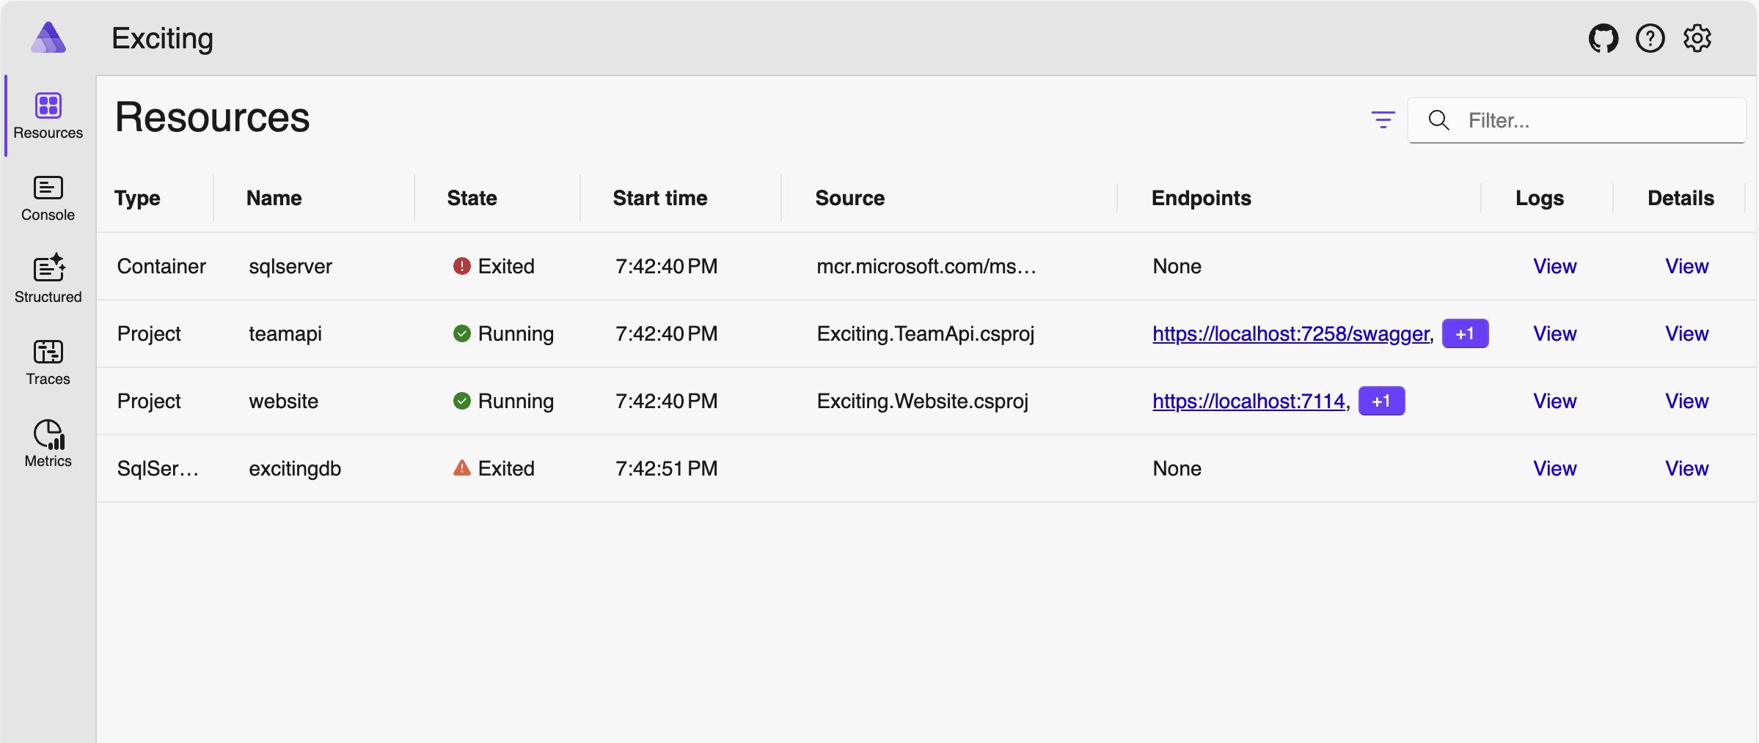
https://learn.microsoft.com/dotnet/aspire/fundamentals/dashboard

Slide 32
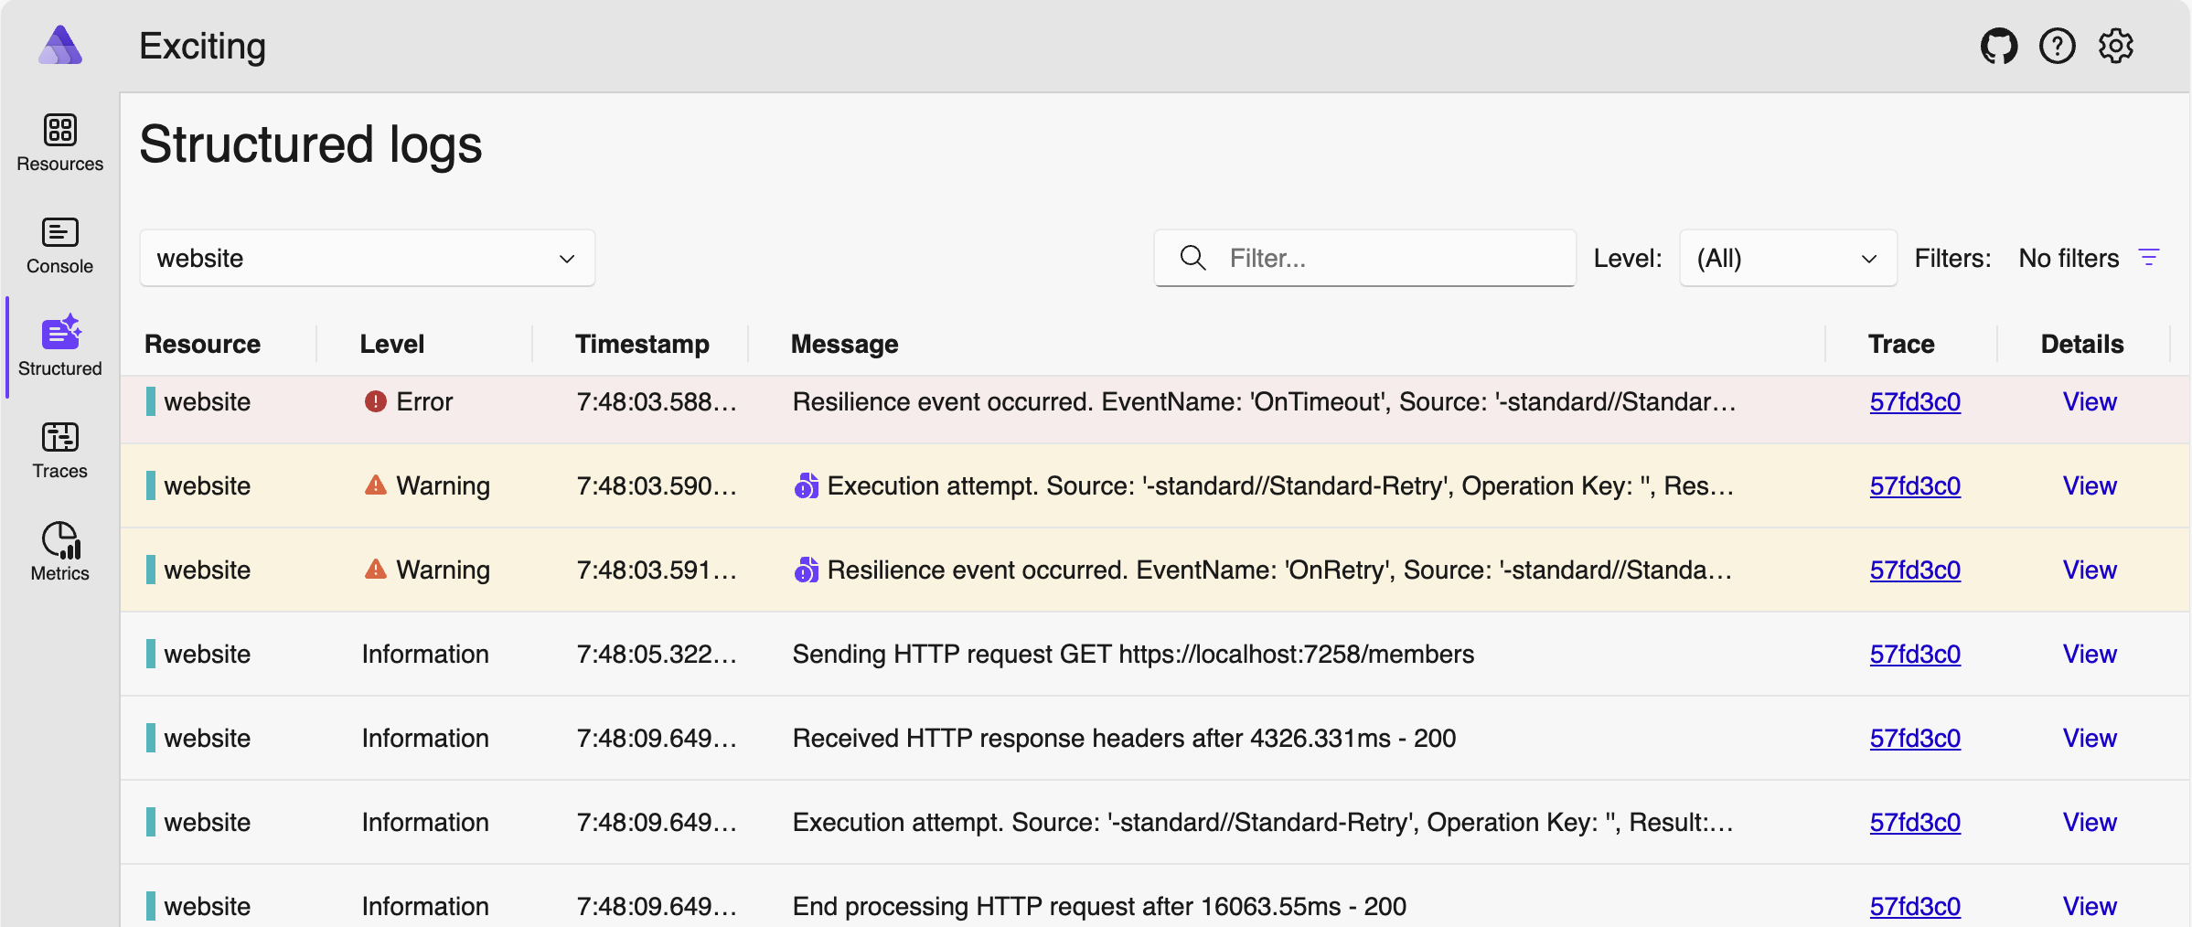
Dashboard
https://learn.microsoft.com/dotnet/aspire/fundamentals/dashboard

Slide 33
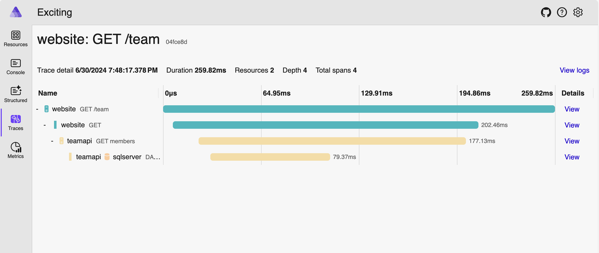
Dashboard
https://learn.microsoft.com/dotnet/aspire/fundamentals/dashboard

Slide 34
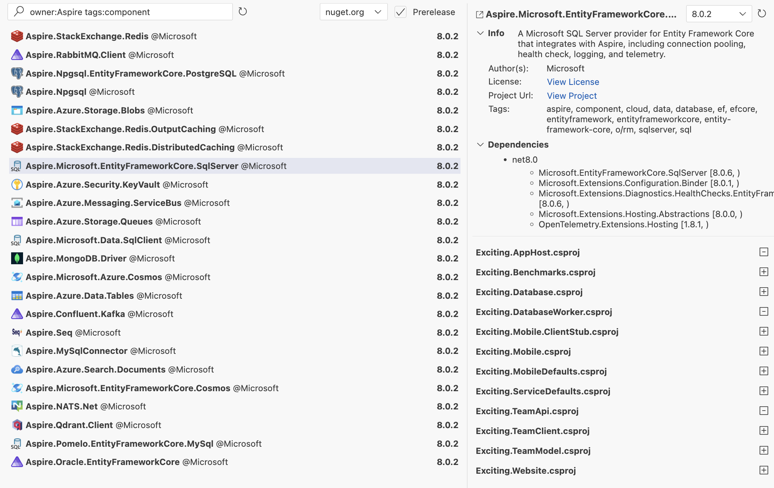
Dashboard
https://www.nuget.org/packages?q=owner%3Aaspire+tag%3Acomponent

Slide 35
Aspire & .NET MAUI
Experiment
Aspire Dashboard Integration
Observable
Request tracing
Endpoint Configuration
Your feedback is needed!

Slide 36






Aspire & .NET MAUI
Experiment
Aspire Dashboard Integration
Observable
Request tracing
Endpoint Configuration
Your feedback is needed!
https://github.com/BretJohnson/aspire-mobile

Slide 37
Resource Manifest
dotnet run --publisher manifest --output-path aspire-manifest.json
{
"resources": {
"sqlpassword": {
"type": "parameter.v0",
"value": "{sqlpassword.inputs.value}",
"inputs": {
"value": {
"type": "string",
"secret": true
}
}
},
"sqlserver": {
"type": "container.v0",
"connectionString":
"Server={sqlserver.bindings.tcp.host},{sqlserver.bindings.tcp.port};
User ID=sa;Password={sqlpassword.value};TrustServerCertificate=true",
"image": "mcr.microsoft.com/mssql/server:2022-latest",
"env": {
"ACCEPT_EULA": "Y",
"MSSQL_SA_PASSWORD": "{sqlpassword.value}"
},
"bindings": {
"tcp": {
"scheme": "tcp",
"protocol": "tcp",
"transport": "tcp",
"targetPort": 1433
}
}
},
"excitingdb": {
"type": "value.v0",
"connectionString": "{sqlserver.connectionString};Database=excitingdb"
},
"teamapi": {
"type": "project.v0",
"path": "../Exciting.TeamApi/Exciting.TeamApi.csproj",
"env": {
"OTEL_DOTNET_EXPERIMENTAL_OTLP_EMIT_EXCEPTION_LOG_ATTRIBUTES": "true",
"OTEL_DOTNET_EXPERIMENTAL_OTLP_EMIT_EVENT_LOG_ATTRIBUTES": "true",
"OTEL_DOTNET_EXPERIMENTAL_OTLP_RETRY": "in_memory",
"ASPNETCORE_FORWARDEDHEADERS_ENABLED": "true",
"ConnectionStrings__excitingdb": "{excitingdb.connectionString}"
},
"bindings": {
"http": {
"scheme": "http",
"protocol": "tcp",
"transport": "http"
},
"https": {
"scheme": "https",
"protocol": "tcp",
"transport": "http"
}
}
},
"website": {
"type": "project.v0",
"path": "../Exciting.Website/Exciting.Website.csproj",
"env": {
"OTEL_DOTNET_EXPERIMENTAL_OTLP_EMIT_EXCEPTION_LOG_ATTRIBUTES": "true",
"OTEL_DOTNET_EXPERIMENTAL_OTLP_EMIT_EVENT_LOG_ATTRIBUTES": "true",
"OTEL_DOTNET_EXPERIMENTAL_OTLP_RETRY": "in_memory",
"ASPNETCORE_FORWARDEDHEADERS_ENABLED": "true",
"services__teamapi__http__0": "{teamapi.bindings.http.url}",
"services__teamapi__https__0": "{teamapi.bindings.https.url}"
},
"bindings": {
"http": {
"scheme": "http",
"protocol": "tcp",
"transport": "http",
"external": true
},
"https": {
"scheme": "https",
"protocol": "tcp",
"transport": "http",
"external": true
}
}
}
}
}
https://learn.microsoft.com/dotnet/aspire/deployment/overview

Slide 38
Aspire Demo

Slide 39

.NET MAUI Hybrid WebView
JS
https://github.com/Eilon/MauiHybridWebView

Slide 40
Write apps using traditional JavaScript, HTML and CSS
Access native APIs from JavaScript web apps
Integrate exiting web apps and controls into native apps
Supports Angular, React, Vue, and even Vanilla JavaScript
Access JavaScript APIs from .NET code
Seamless UX experience for web and native controls
JavaScript Apps

Slide 41
Permanent Tunnels
XAML
<hwv:HybridWebView
x:Name="notesEditor"
HybridAssetRoot="wysiwyg-editor"
MainFile="index.html" />
C#
notesEditor.JSInvokeTarget = new NotesViewModel();

Slide 42
Permanent Tunnels
C#
class NotesViewModel
{
private NoteItem noteItem;
public void UpdateTaskNotes(string? notes)
{
if (noteItem is null)
return;
if (string.IsNullOrWhiteSpace(notes))
noteItem.Notes = null;
else
noteItem.Notes = notes.Trim();
}
public string GetTaskNotes()
{
if (noteItem is null)
return "";
return noteItem.Notes ?? "";
}
}

Slide 43
Permanent Tunnels
HTML
<html lang="en">
<head>
<meta charset="UTF-8">
<title></title>
<script src="_hwv/HybridWebView.js"></script>
<script src="jquery-3.4.1.slim.min.js"></script>
<link href="summernote-lite.min.css" rel="stylesheet">
<script src="summernote-lite.min.js"></script>
<script src="app.js"></script>
</head>
<body>
<div id="summernote"></div>
</body>
</html>

Slide 44
Permanent Tunnels
JS
function setTaskNotes(contents) {
$('#summernote').summernote('code', contents);
}
function onChangeCallback(contents, $editable) {
var params = [ contents ];
HybridWebView.SendInvokeMessageToDotNet('UpdateTaskNotes', params);
}
async function onInitCallback() {
var contents = await HybridWebView.SendInvokeMessageToDotNetAsync('GetTaskNotes');
setTaskNotes(contents);
}
$('#summernote').summernote({
callbacks: {
onChange: onChangeCallback,
onInit: onInitCallback,
}
});

Slide 45

Coming to a .NET SDK near you!
Your feedback is needed!
https://github.com/dotnet/maui/pull/22880

Slide 46
Hybrid WebView Demo

Slide 47

NuGet.org
https://nuget.org

Slide 48
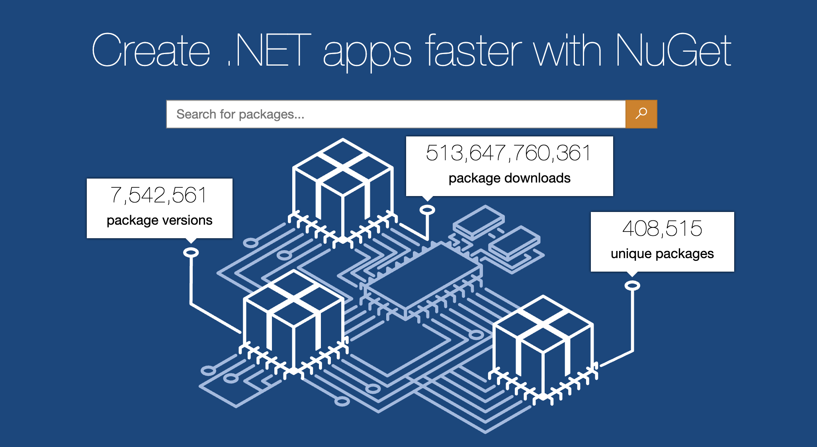

Slide 49

Community Toolkit
https://github.com/CommunityToolkit

Slide 50
.NET Community Toolkit
https://learn.microsoft.com/dotnet/communitytoolkit/introduction

Slide 51
MVVM Helpers
Diagnostics
Code Guards
Exception Helpers
High Performance Types
Span2D Memory2D
Pools
Parallelization Helpers
https://learn.microsoft.com/dotnet/communitytoolkit/maui

Slide 52
Permanent Tunnels
public partial class MembersViewModel : INotifyPropertyChanged
{
private bool isRefreshing;
public bool IsRefreshing {
get => isRefreshing;
set {
isRefreshing = value;
OnPropertyChanged(nameof(IsRefreshing));
}
}
private ICommand? refreshCommand;
public ICommand RefreshCommand =>
refreshCommand ??= new Command(async () => await Refresh());
private async Task Refresh() {
// ...
}
public event PropertyChangedEventHandler? PropertyChanged;
protected void OnPropertyChanged(string propertyName) =>
PropertyChanged?.Invoke(this, new PropertyChangedEventArgs(propertyName));
}
https://learn.microsoft.com/dotnet/communitytoolkit/mvvm/

Slide 53
Permanent Tunnels
public partial class MembersViewModel : ObservableObject
{
private bool isRefreshing;
public bool IsRefreshing {
get => isRefreshing;
set {
isRefreshing = value;
OnPropertyChanged(nameof(IsRefreshing));
}
}
private ICommand? refreshCommand;
public ICommand RefreshCommand =>
refreshCommand ??= new Command(async () => await Refresh());
private async Task Refresh() {
// ...
}
}
https://learn.microsoft.com/dotnet/communitytoolkit/mvvm/

Slide 54
Permanent Tunnels
public partial class MembersViewModel : ObservableObject
{
private bool isRefreshing;
public bool IsRefreshing {
get => isRefreshing;
set {
isRefreshing = value;
OnPropertyChanged();
}
}
private ICommand? refreshCommand;
public ICommand RefreshCommand =>
refreshCommand ??= new Command(async () => await Refresh());
private async Task Refresh() {
// ...
}
}
https://learn.microsoft.com/dotnet/communitytoolkit/mvvm/

Slide 55
Permanent Tunnels
public partial class MembersViewModel : ObservableObject
{
[ObservableProperty]
private bool isRefreshing;
private ICommand? refreshCommand;
public ICommand RefreshCommand =>
refreshCommand ??= new Command(async () => await Refresh());
private async Task Refresh() {
// ...
}
}
https://learn.microsoft.com/dotnet/communitytoolkit/mvvm/

Slide 56
Permanent Tunnels
public partial class MembersViewModel : ObservableObject
{
[ObservableProperty]
private bool isRefreshing;
[RelayCommand]
private async Task Refresh() {
// ...
}
}
https://learn.microsoft.com/dotnet/communitytoolkit/mvvm/

Slide 57
Permanent Tunnels
public partial class MembersViewModel : ObservableObject
{
[ObservableProperty]
private bool isRefreshing;
[RelayCommand]
private async Task Refresh() {
// ...
}
}
https://learn.microsoft.com/dotnet/communitytoolkit/mvvm/

Slide 58
Permanent Tunnels
public partial class EditPersonViewModel : ObservableObject
{
[ObservableProperty]
[NotifyPropertyChangedFor(nameof(FullName))]
string firstName = "";
[ObservableProperty]
[NotifyPropertyChangedFor(nameof(FullName))]
string lastName = "";
public string FullName => $"{FirstName} {LastName}";
}
https://learn.microsoft.com/dotnet/communitytoolkit/mvvm/

Slide 59

.NET MAUI Community Toolkit
https://learn.microsoft.com/dotnet/communitytoolkit/maui

Slide 60
Snackbar
Toast
Animations
Behaviours
Converters
AppTheme Resources
Badges
Folder Picker
File Saver
Speech to Text
Extension Methods
Gravatar Image Source
Dock Layout
State Container
Uniform Items Layout
Platform Specifics
Avatar View
Camera View
Drawing View
Expander
Lazy View
Media Element
Popups
C# Markup
Native Library Interop
Slim Bindings
https://learn.microsoft.com/dotnet/communitytoolkit/maui

Slide 61
Permanent Tunnels
<PackageReference Include="CommunityToolkit.Maui" />
using CommunityToolkit.Maui;
public static class MauiProgram
{
public static MauiApp CreateMauiApp()
{
var builder = MauiApp.CreateBuilder();
builder
...
.UseMauiCommunityToolkit() // <- this line
...;
return builder.Build();
}
}
https://learn.microsoft.com/dotnet/communitytoolkit/maui/get-started

Slide 62
Permanent Tunnels
<ContentPage
x:Class="CommunityToolkit.Maui.Sample.Pages.MyPage"
xmlns="http://schemas.microsoft.com/dotnet/2021/maui"
xmlns:x="http://schemas.microsoft.com/winfx/2009/xaml"
xmlns:toolkit="http://schemas.microsoft.com/dotnet/2022/maui/toolkit">
<Grid RowDefinitions="*,Auto,*">
<toolkit:CameraView
x:Name="cameraView"
MediaCaptured="OnMediaCaptured" />
<Button
Grid.Row="1"
Clicked="OnCaptureImage"
Text="Capture Image" />
<Image
Grid.Row="2"
x:Name="previewImage" />
</Grid>
</ContentPage>
https://learn.microsoft.com/dotnet/communitytoolkit/maui/views/camera-view

Slide 63
Permanent Tunnels
async void OnCaptureImage(object? sender, EventArgs e)
{
await cameraView.CaptureImage(default);
}
void OnMediaCaptured(object? sender, MediaCapturedEventArgs e)
{
var stream = new MemoryStream();
e.Media.CopyTo(stream);
stream.Position = 0;
Dispatcher.Dispatch(() =>
{
previewImage.Source = ImageSource.FromStream(() => stream);
});
}
https://learn.microsoft.com/dotnet/communitytoolkit/maui/views/camera-view

Slide 64
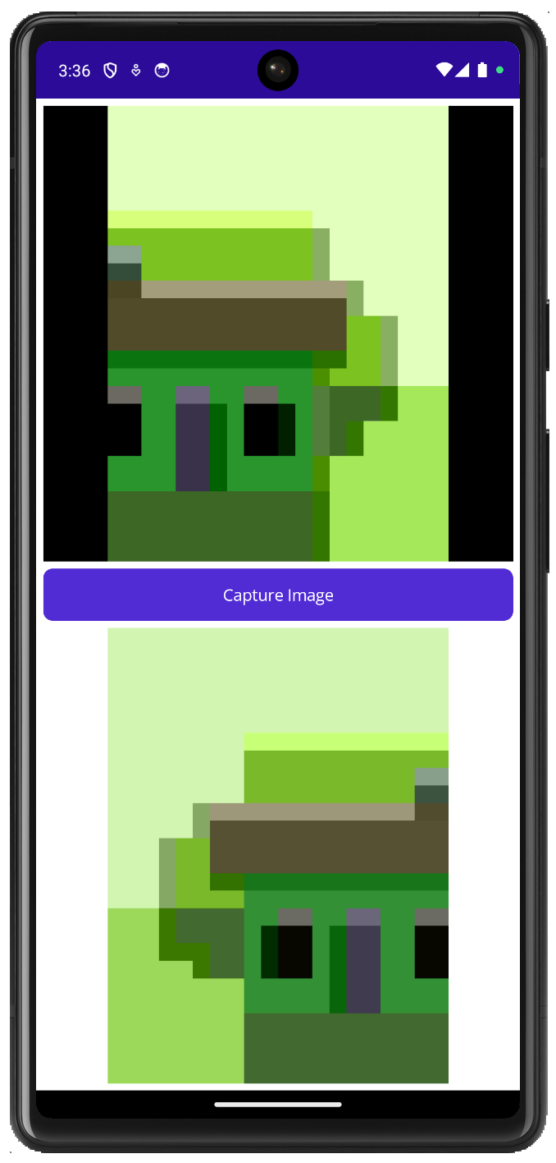
Permanent Tunnels
https://learn.microsoft.com/dotnet/communitytoolkit/maui/views/camera-view

Slide 65

Docker
https://www.docker.com

Slide 66
Ensures consistent application behavior
Lightweight and efficient
Enhances application security
Ideal for microservices architectures
Supported by a robust community and ecosystem
Runs seamlessly across different platforms
Application Containerization

Slide 67






Client
Host
Registry
Daemon
docker pull
my-app-ai
my-app-db
docker build
my-app-api
my-app-web
.NET
.NET
docker run
.NET
.NET
Containers
Images
https://docs.docker.com/guides/docker-overview

Slide 68
Example: MS SQL Server on macOS
docker pull mcr.microsoft.com/azure-sql-edge:latest
docker run \
-e "ACCEPT_EULA=Y" \
-e "MSSQL_SA_PASSWORD=MyPass@word" \
-v /data/sqldata:/var/opt/mssql
-p 1433:1433 \
-d \
mcr.microsoft.com/azure-sql-edge:latest
https://learn.microsoft.com/sql/linux/sql-server-linux-overview

Slide 69
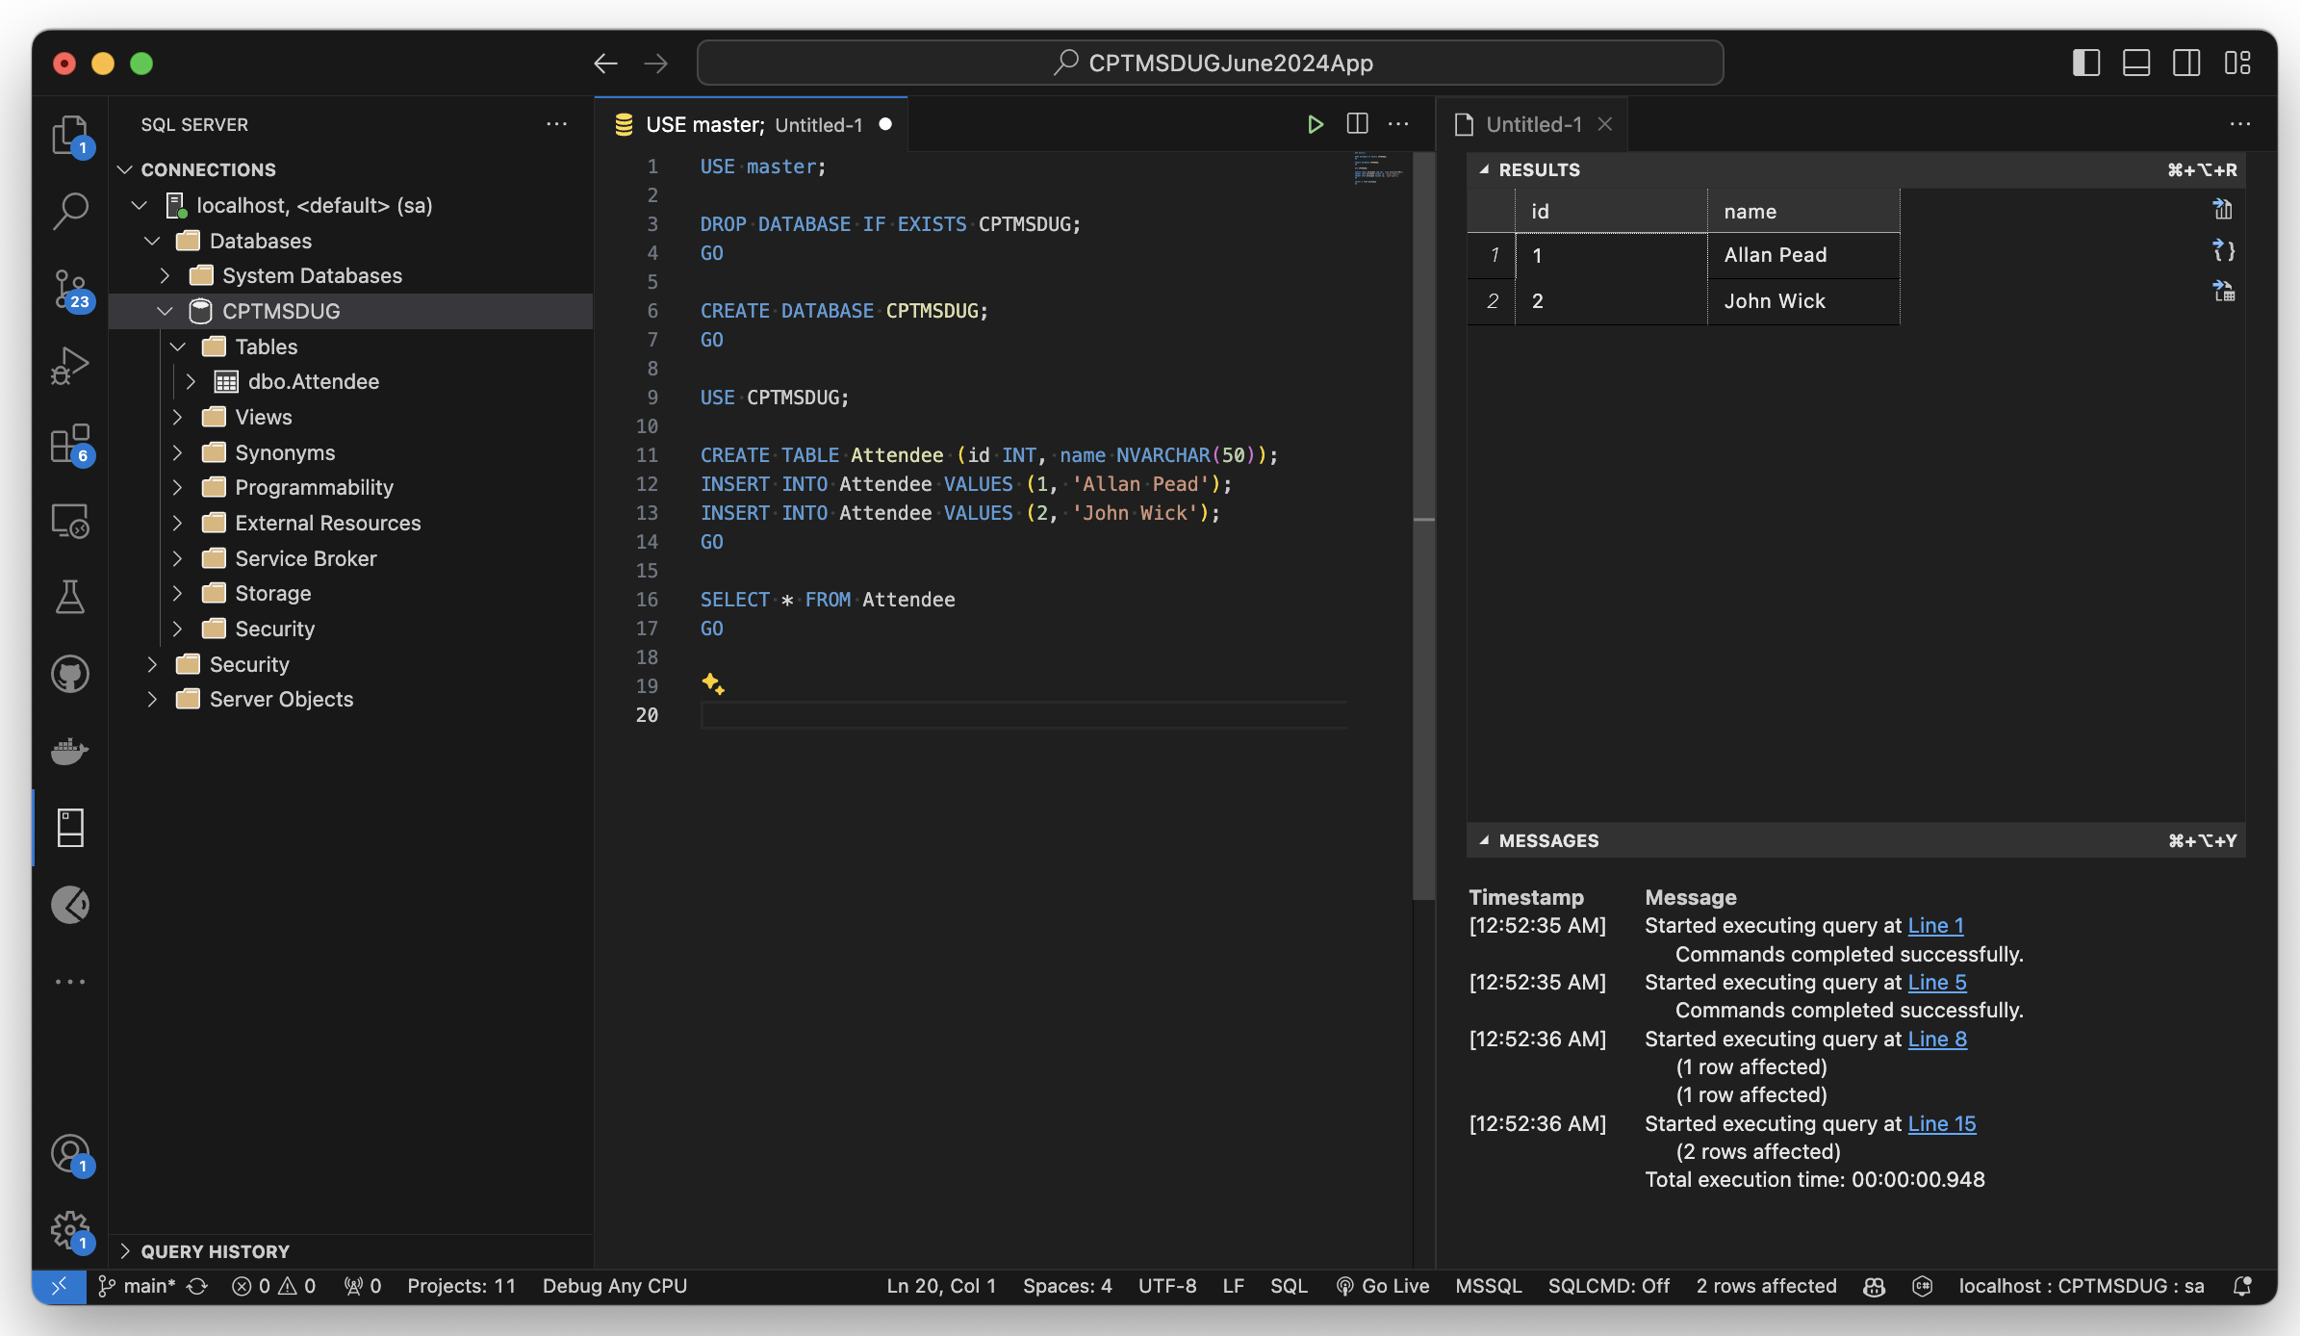
SQL Server VS Code Extension
https://marketplace.visualstudio.com/items?itemName=ms-mssql.mssql

Slide 70
Dockerfile
FROM mcr.microsoft.com/dotnet/sdk:8.0 AS build-env
WORKDIR /working
COPY . ./
RUN dotnet restore
RUN dotnet publish -c Release -o out
FROM mcr.microsoft.com/dotnet/aspnet:8.0
WORKDIR /app
COPY --from=build-env /working/out .
ENTRYPOINT ["dotnet", "MyApp.dll"]

Slide 71
docker build & run
docker build -t my-image-name .
docker run -it --rm -p 8080:8080 my-image-name

Slide 72
Docker + SQL Server Demo

Slide 73
.NET MAUI Profiling Demo

Slide 74
Benchmark Demo

Slide 75
UI Testing Demo

Slide 76
Links
https://aka.ms/profile-maui
* **dotnet-trace** - https://learn.microsoft.com/dotnet/core/diagnostics/dotnet-trace
* appium
* efcore tools https://learn.microsoft.com/ef/core/get-started/overview/install#get-the-net-core-cli-tools
* efcore - https://learn.microsoft.com/ef/core/
* ef mapping - https://learn.microsoft.com/ef/core/modeling/relationships/mapping-attributes
* dev tunnels - https://devblogs.microsoft.com/dotnet/dev-tunnels-a-game-changer-for-mobile-developers/
* diagnostics - https://learn.microsoft.com/dotnet/core/diagnostics
aspire-docs-samples
* **aspire-mobile** - https://github.com/BretJohnson/aspire-mobile
* aspire-samples - https://github.com/dotnet/aspire-samples
* aspire-docs-samples - https://github.com/MicrosoftDocs
* **.NET Blog** - https://devblogs.microsoft.com/dotnet/category/dotnet
* **.NET MAUI Blog** - https://devblogs.microsoft.com/dotnet/category/maui
* **Artifacts output layout** - https://learn.microsoft.com/dotnet/core/sdk/artifacts-output
* **Central Package Management (CPM)** - https://learn.microsoft.com/nuget/consume-packages/Central-Package-Management

Slide 77
Links
https://devblogs.microsoft.com/dotnet/dev-tunnels-a-game-changer-for-mobile-developers
https://github.com/MicrosoftDocs/aspire-docs-samples
https://github.com/dotnet/aspire-samples
https://devblogs.microsoft.com/dotnet/category/dotnet
https://devblogs.microsoft.com/dotnet/category/maui
https://learn.microsoft.com/dotnet/core/sdk/artifacts-output
https://learn.microsoft.com/nuget/consume-packages/Central-Package-Management
https://aka.ms/profile-maui
https://benchmarkdotnet.org

Slide 78

Thanks!

